Slide 1





MediTalk
Outpatient Doctor Appointment System
Team Members
Ananya Krishna
Anirban Manna
Sekhar Vishal
Jinu Mistika
Nikhil Patil Manoj Raj
Ayuska Singh
Varshini Neralla Navyashree
InfosysSpringboard EDoctor Project

Slide 2



Features of the Project
01
Easy appointment booking
04
Notification
02
Doctor availability
03
Schedule Management

Slide 3
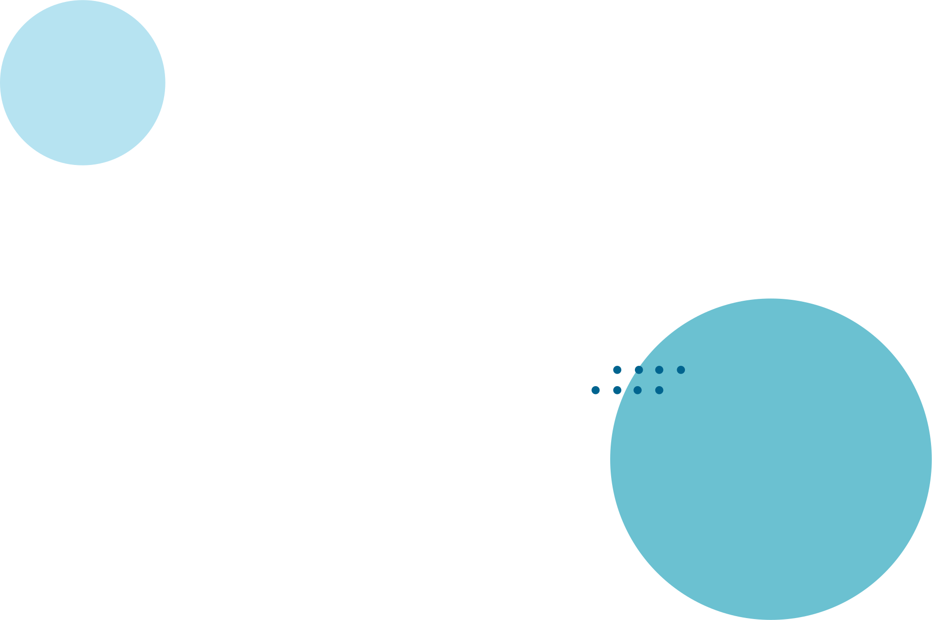



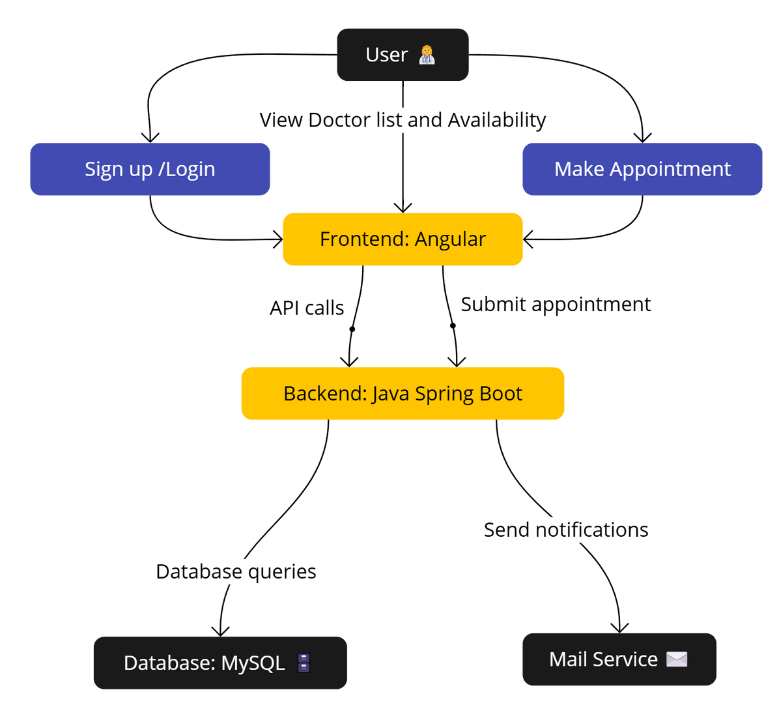
Technology Stack
Frontend : Angular17,Html5, CSS3 , TypeScript
Backend : Java Springboot
DataBase : My SQL

Slide 4


Modules

Slide 5

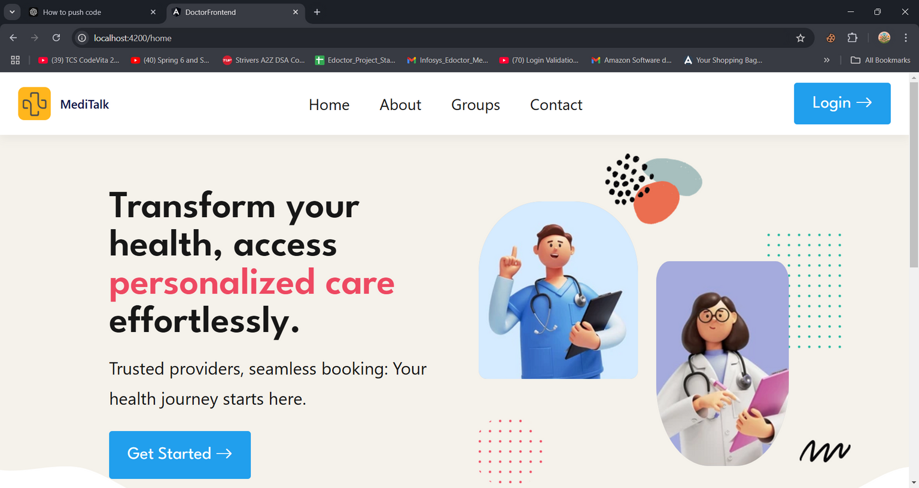


1.User Authentication and registration:

Slide 6


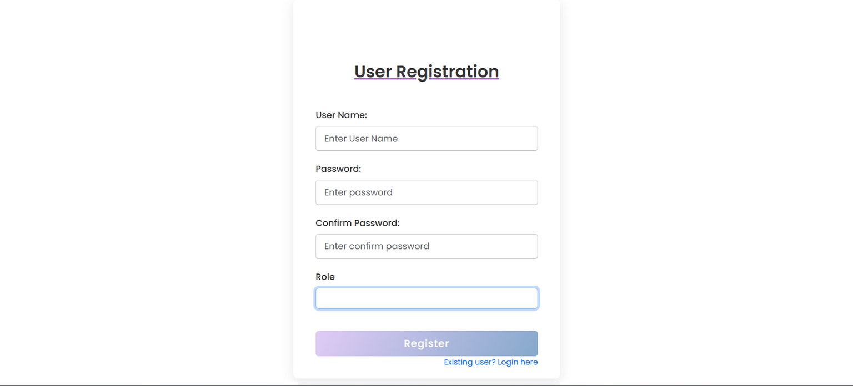
User registration Page:

Slide 7
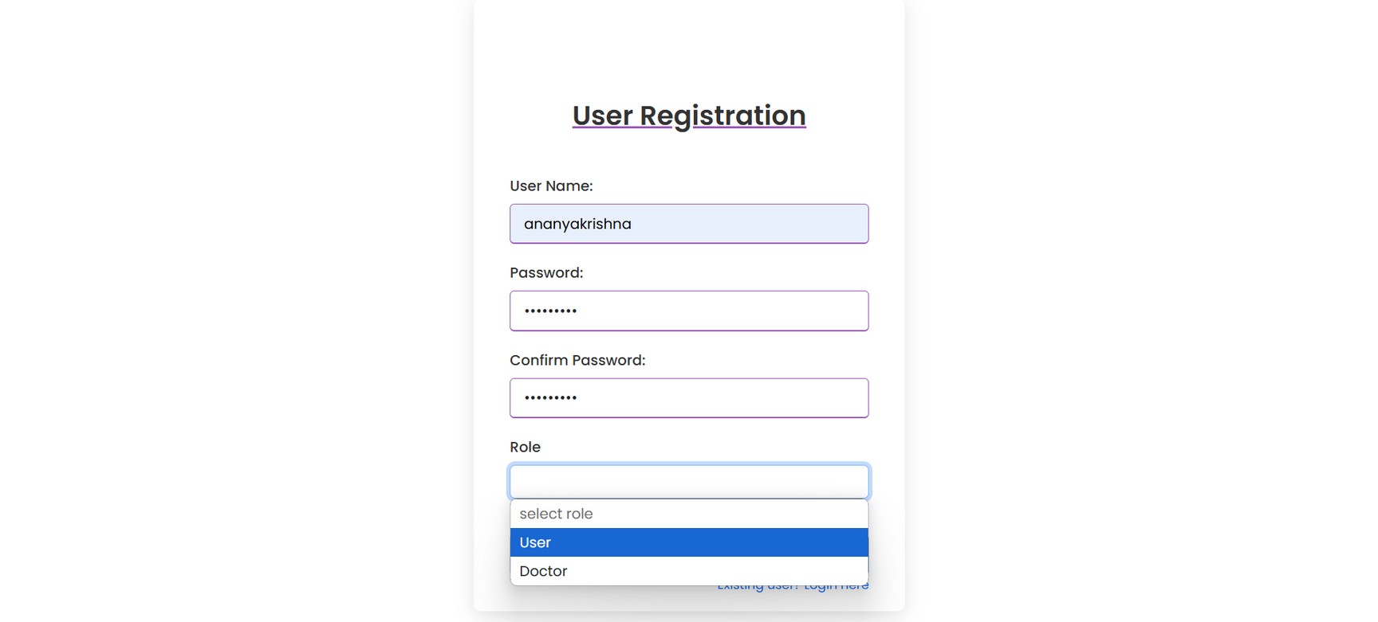
Role based registration:

Slide 8
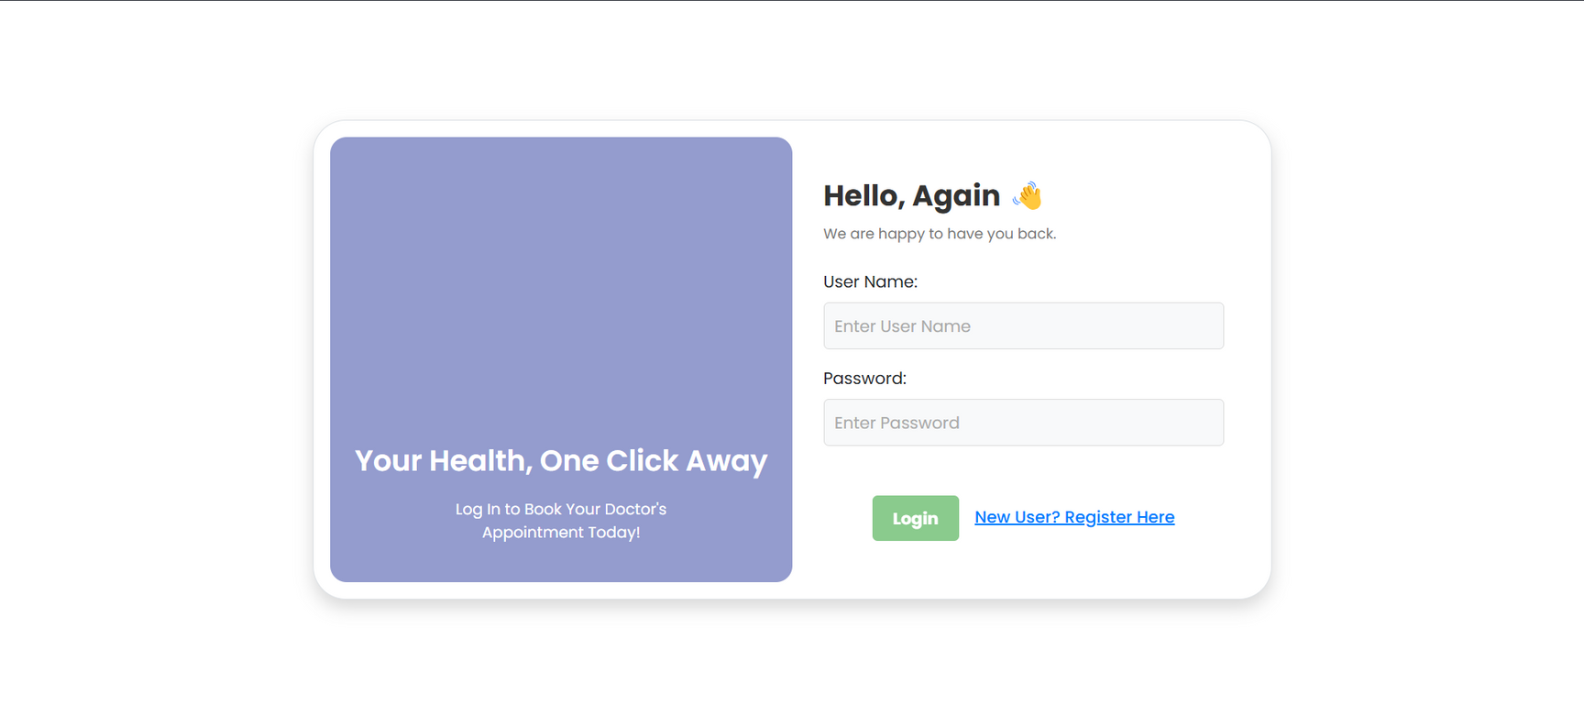
User Login:

Slide 9

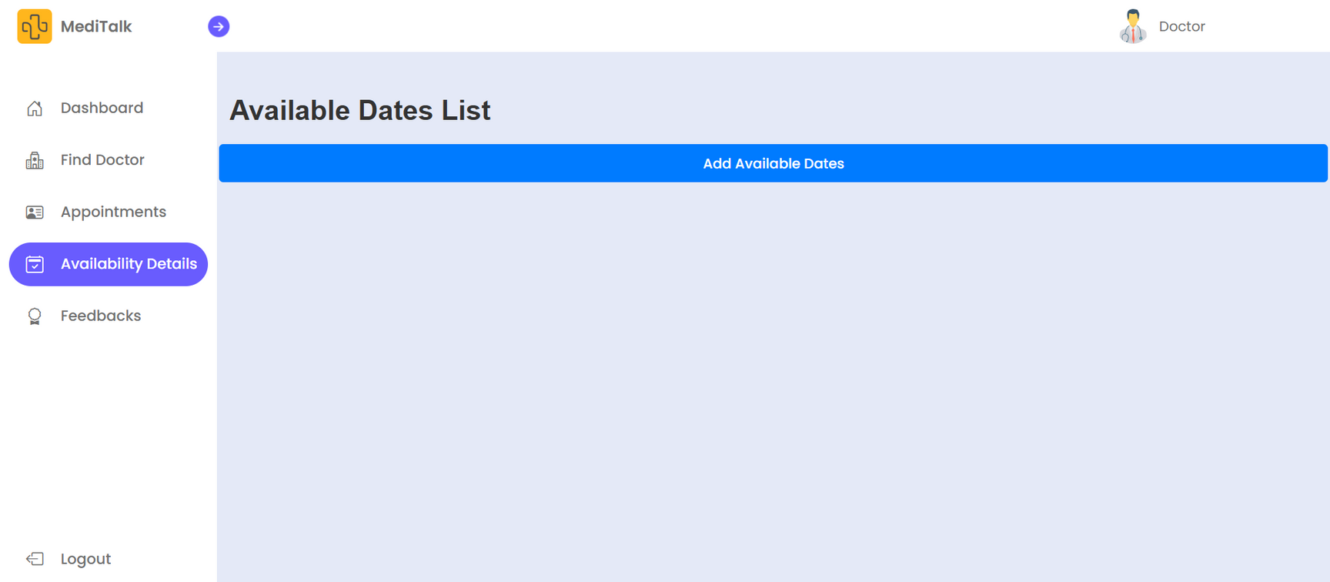

2.Appointment Scheduling interface

Slide 10
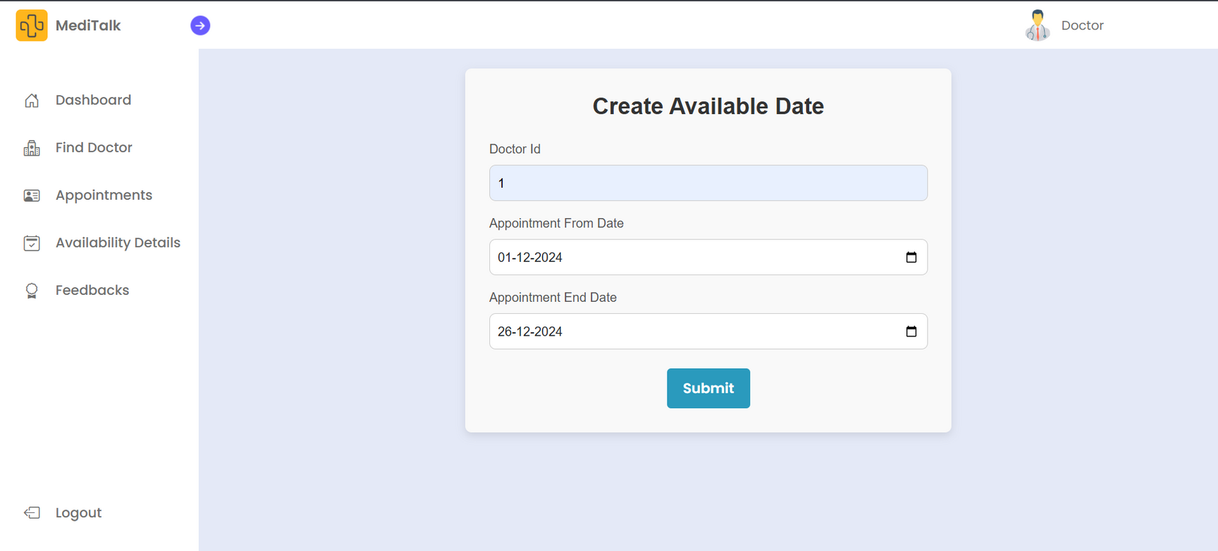

Slide 11


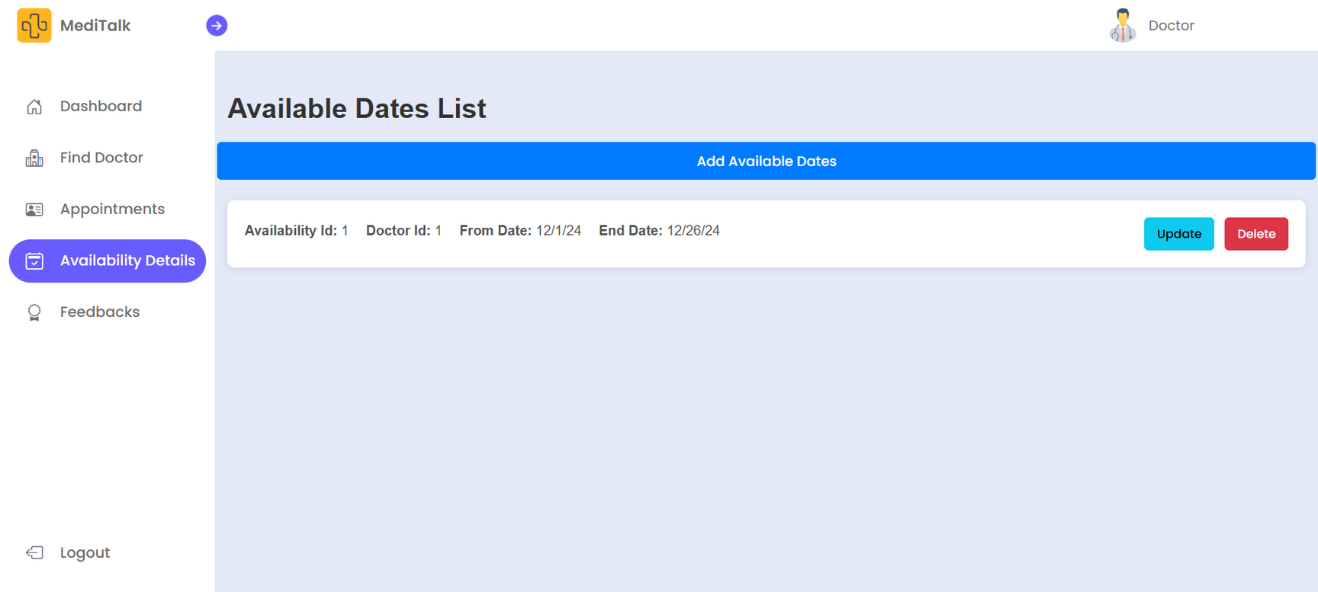


Slide 12
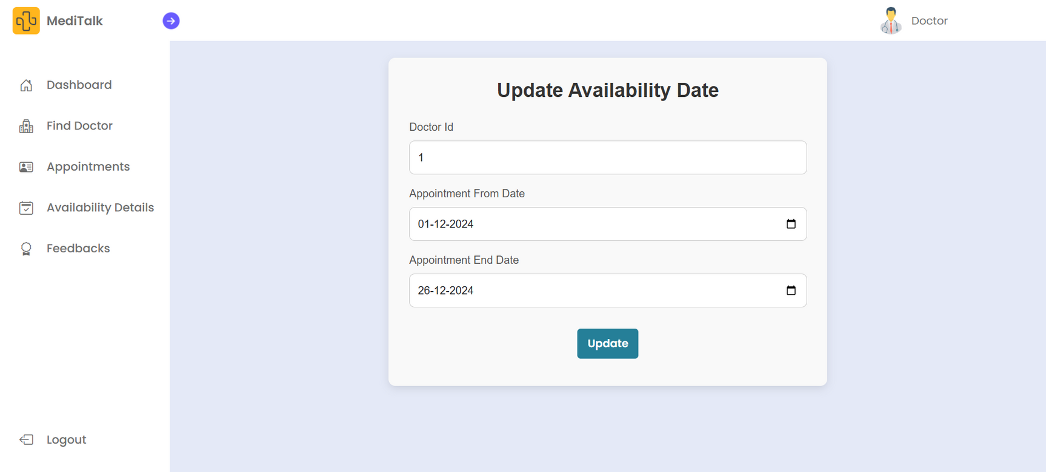

Slide 13
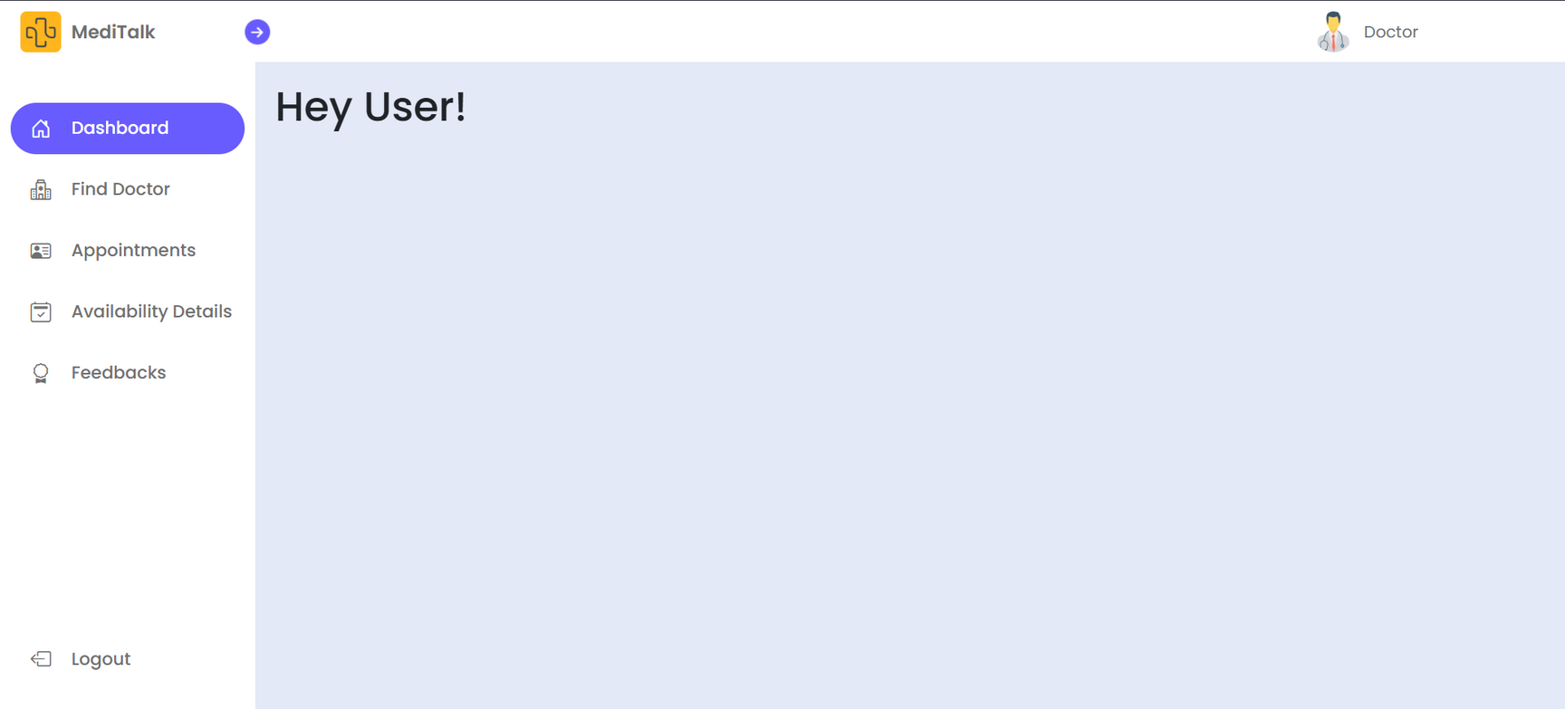
3.Doctor Availability management

Slide 14
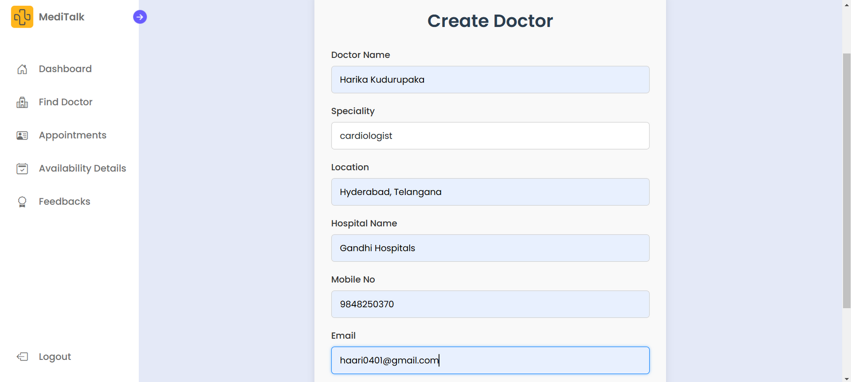

Slide 15
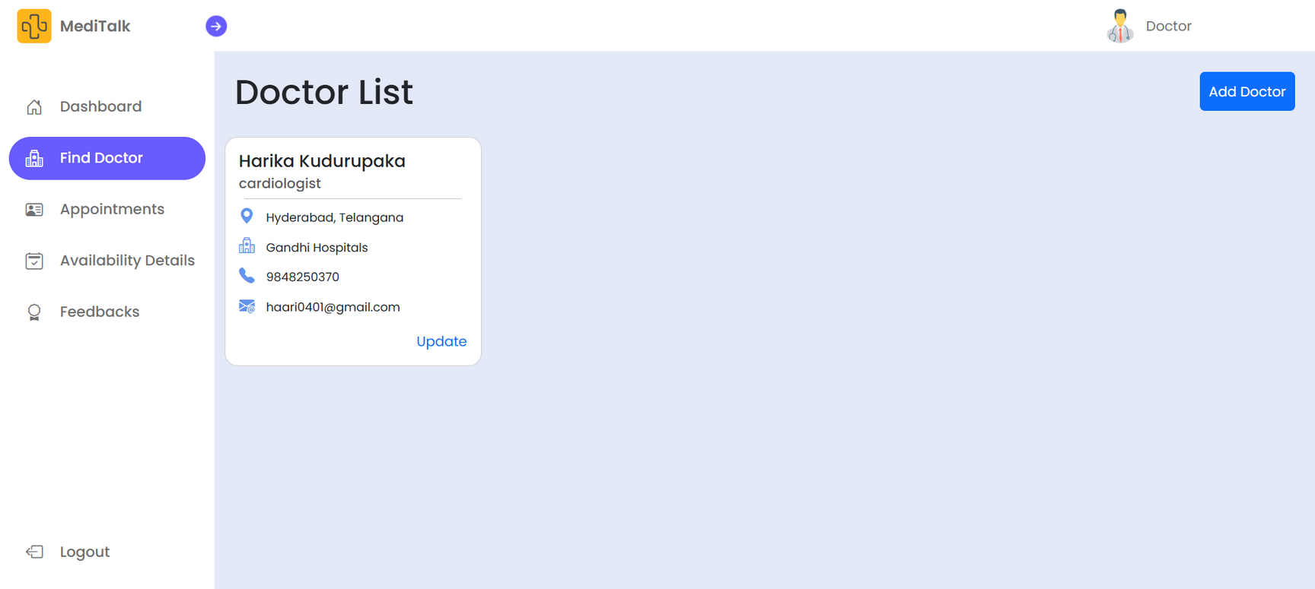

Slide 16
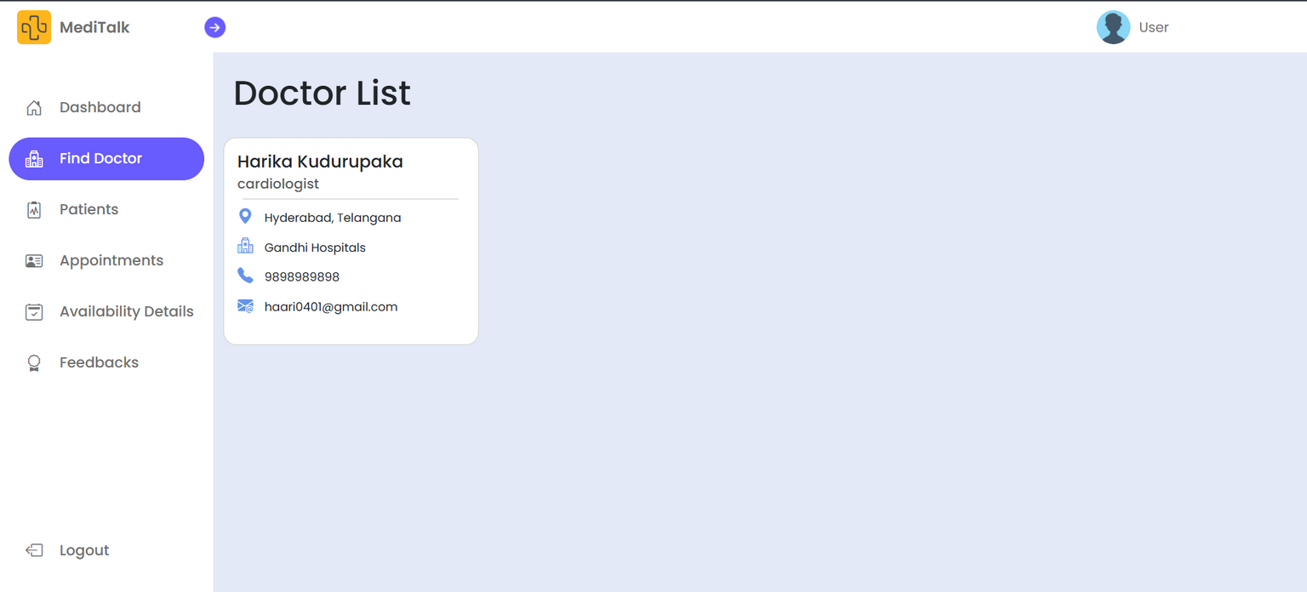

Slide 17
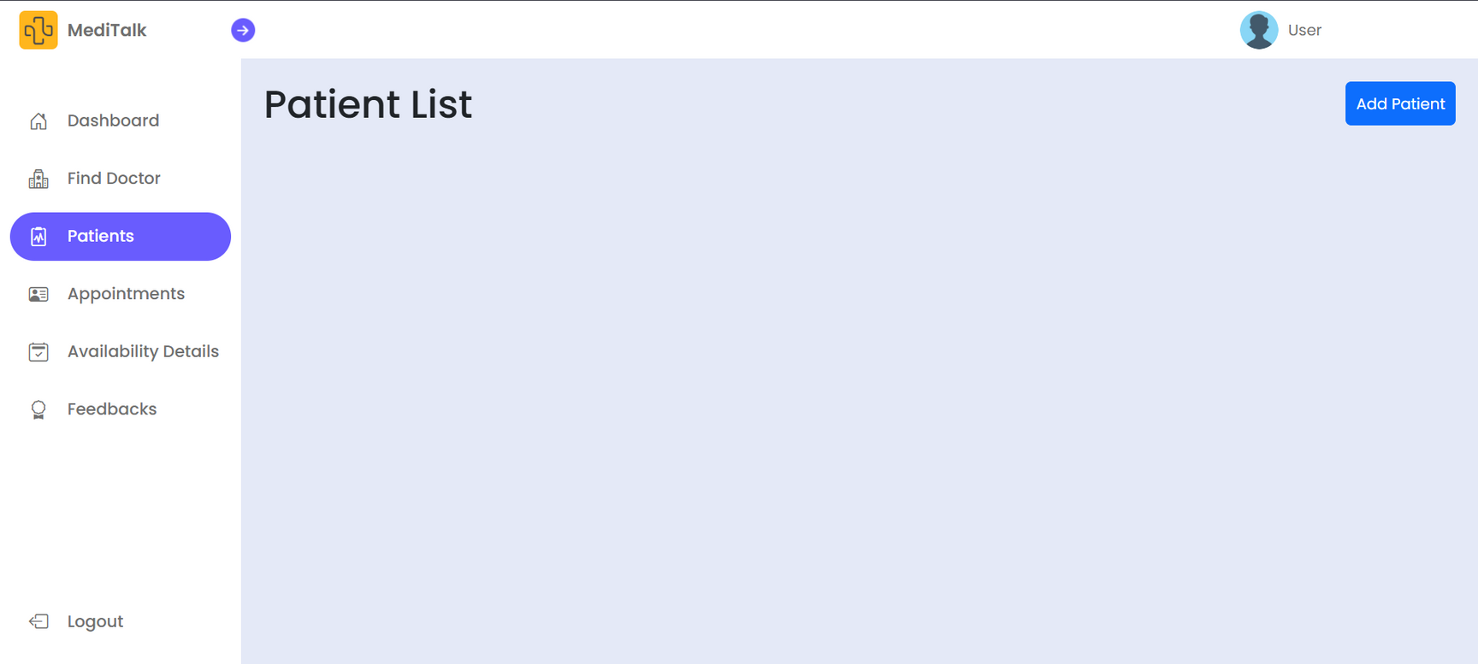
4.Patient Availability management

Slide 18
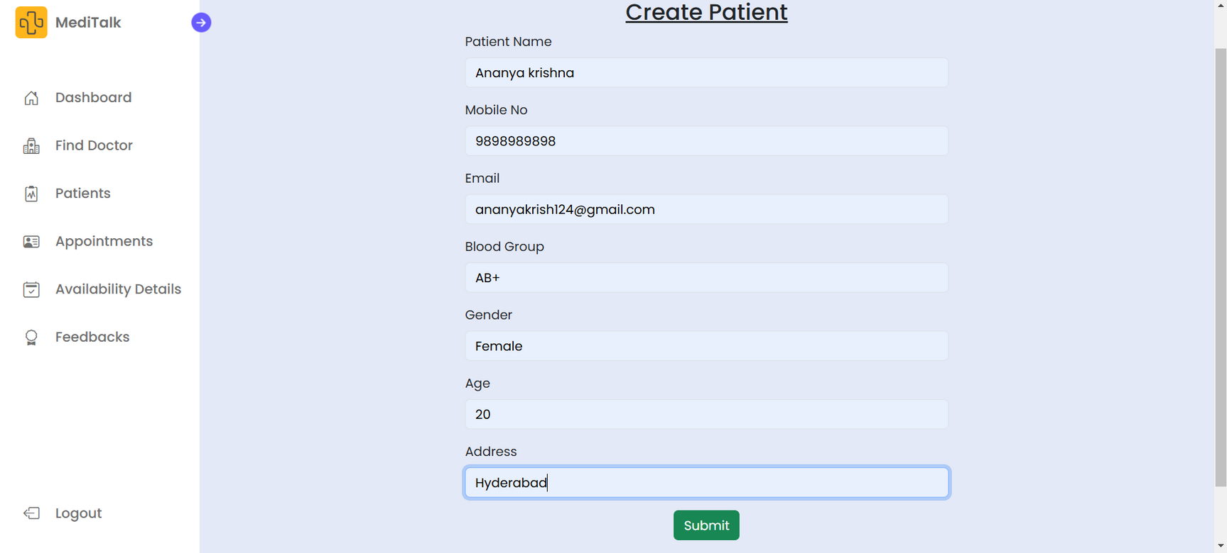

Slide 19
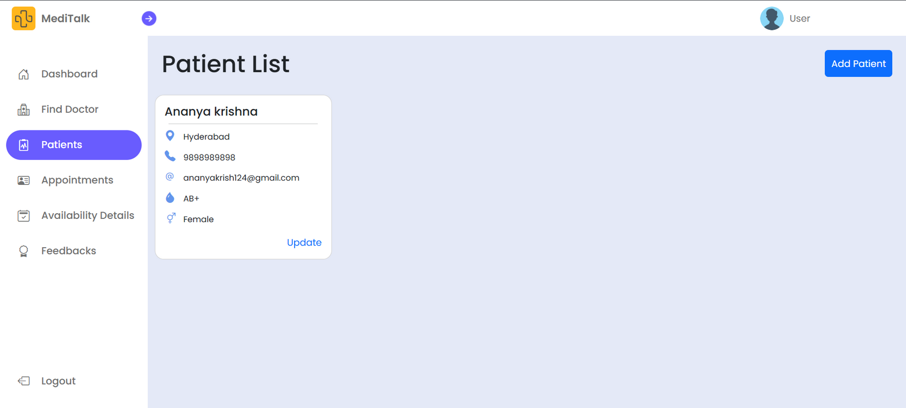

Slide 20
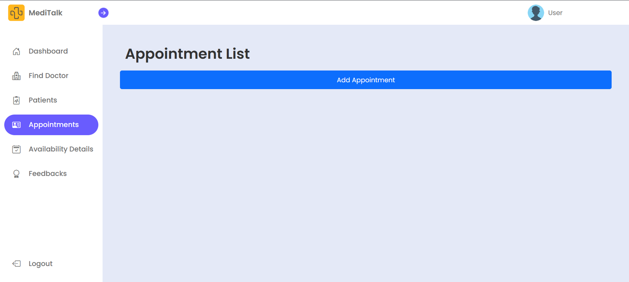
5.Appointment management

Slide 21
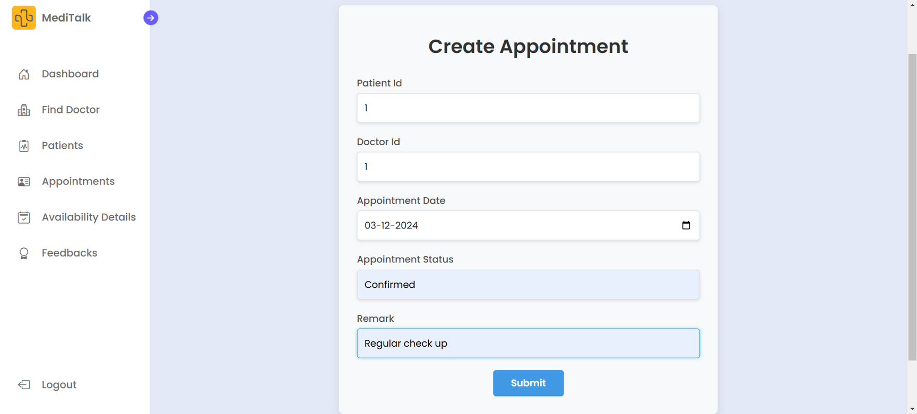

Slide 22
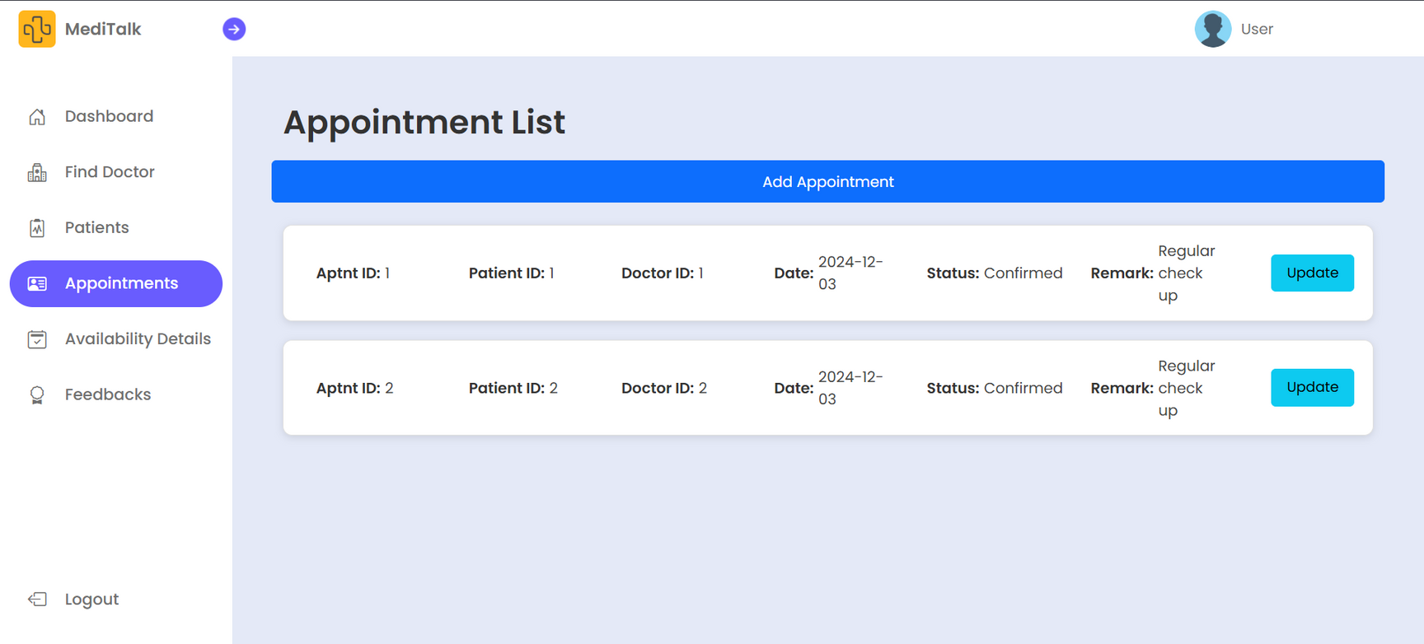

Slide 23
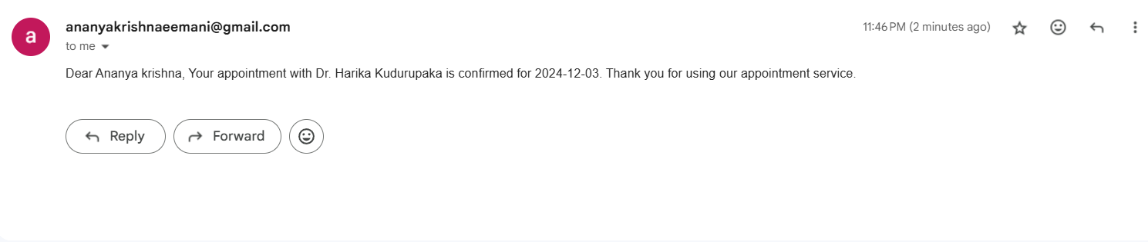
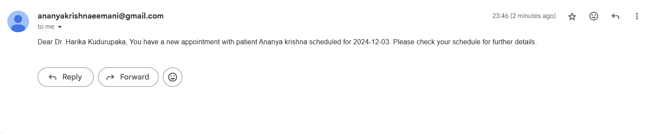
6.Notification System & Feedback service

Slide 24
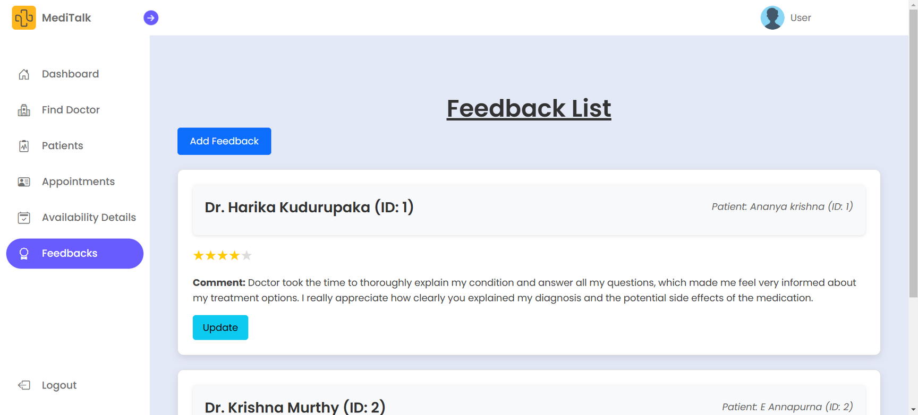

Slide 25
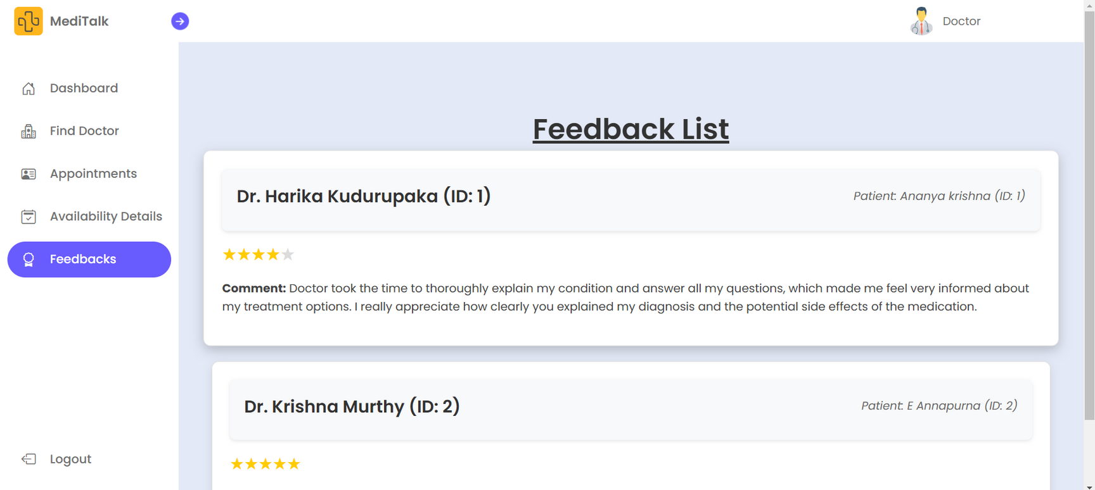

Slide 26
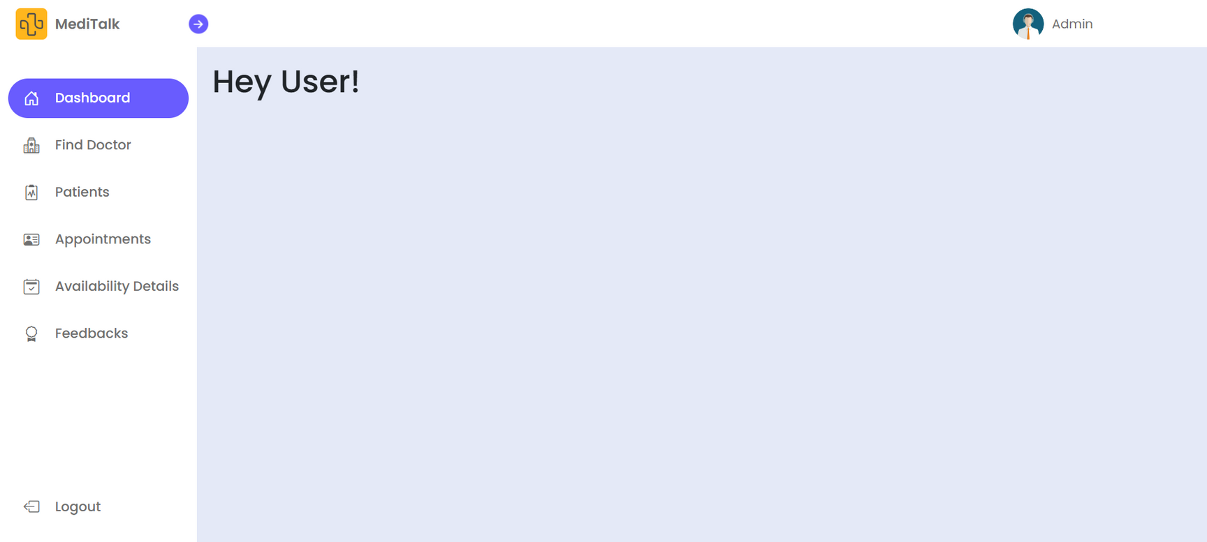
7. Admin’s Dashboard

Slide 27
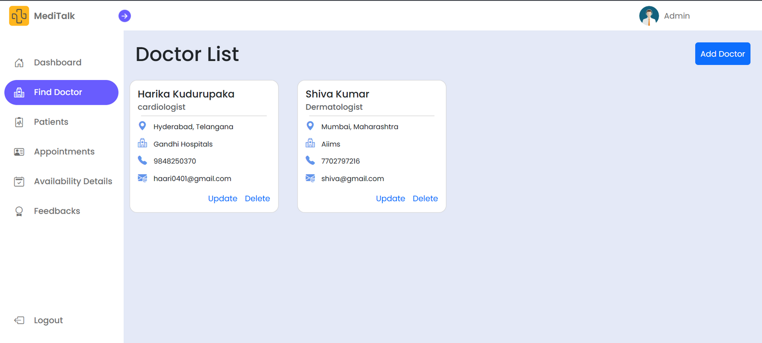

Slide 28
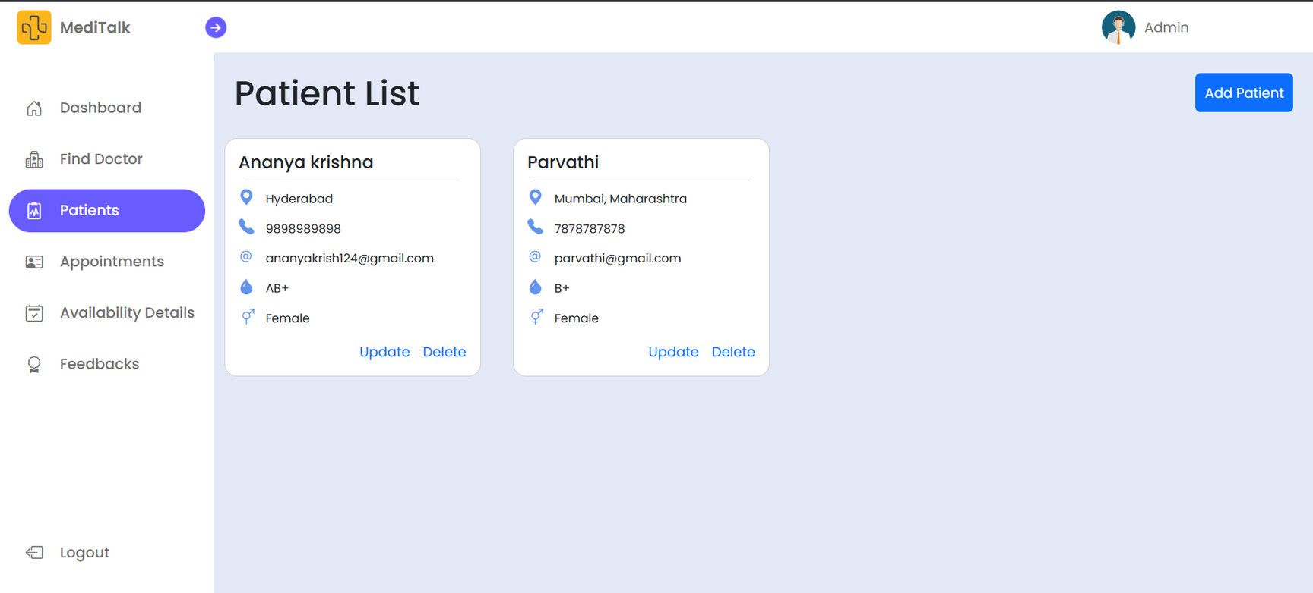

Slide 29
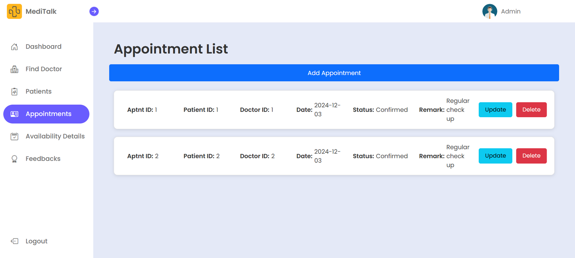

Slide 30
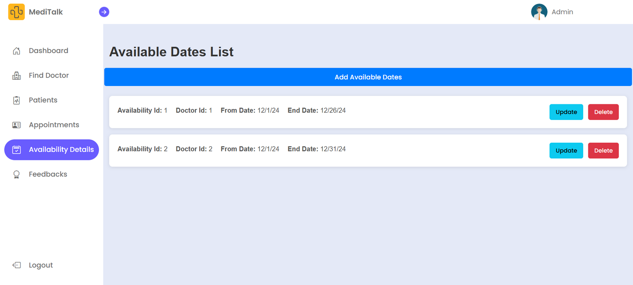

Slide 31
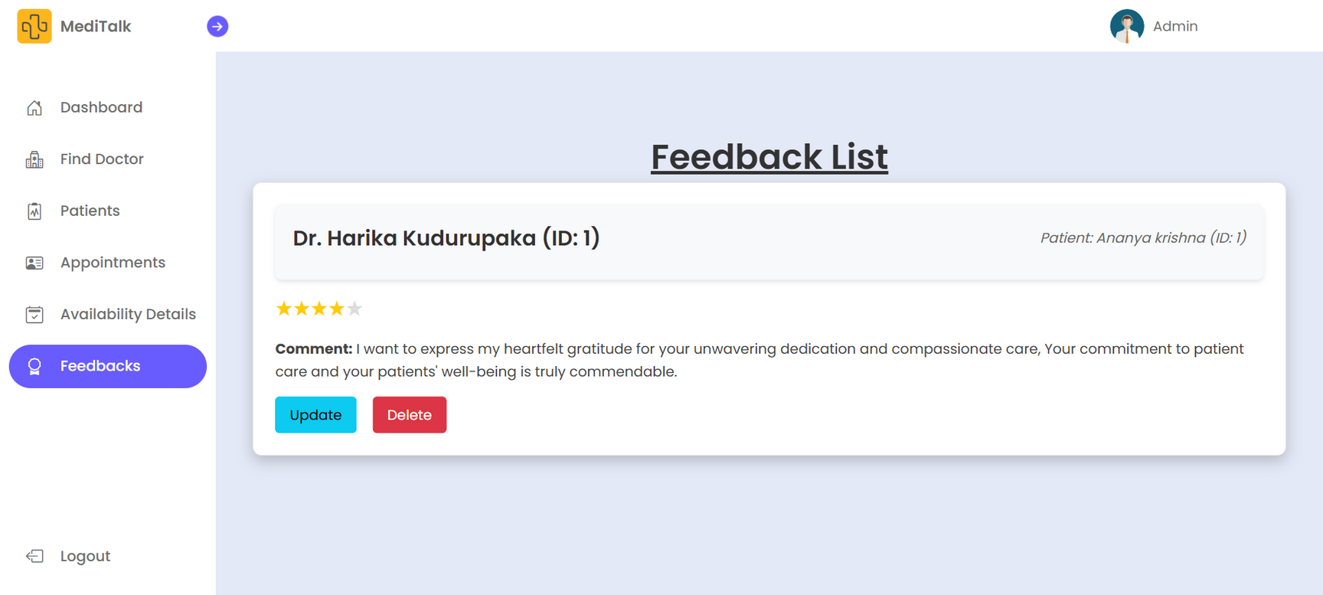

Slide 32


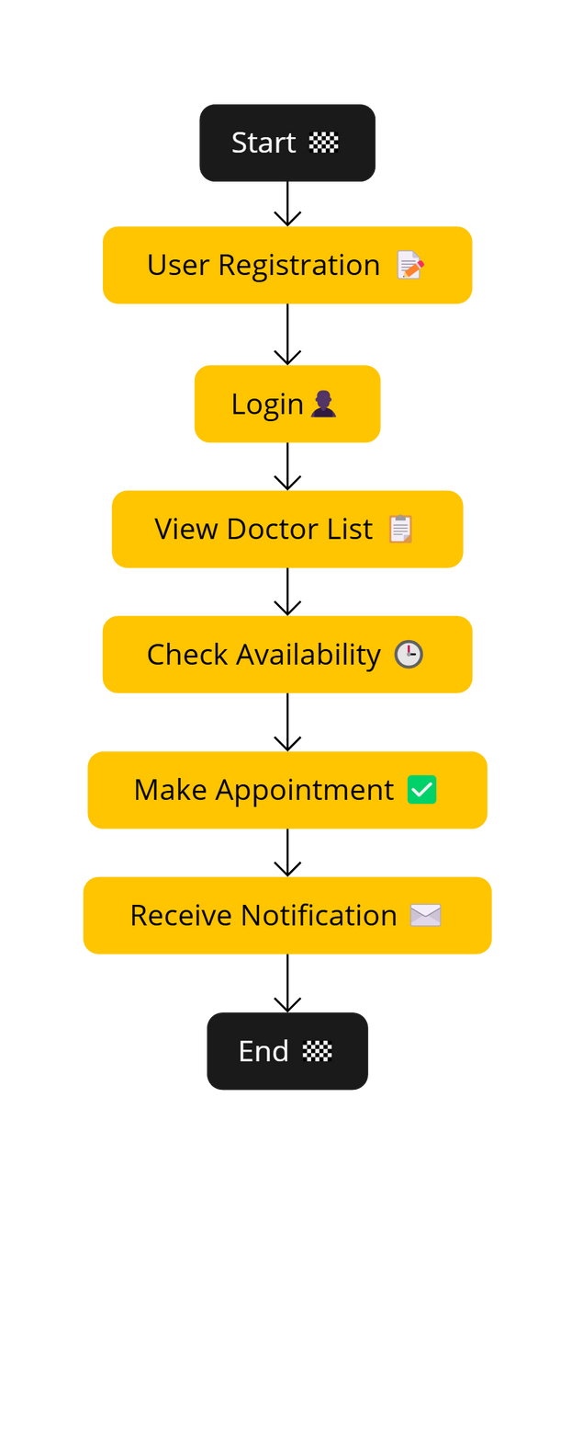



Workflow
For Patients:
Ease of booking appointments.
Send Notification
Access to doctor profiles
For Doctors:
Efficient schedule management.
Better patient handling.
Improved patient communication.

Slide 33



1. Streamlined Healthcare Access
Our Doctor Appointment System simplifies the process of booking appointments, making healthcare more accessible and efficient.
2 . Enhanced User Experience
Patients can easily register, view doctors' availability, and book appointments from the comfort of their homes.
3 . Benefits for All Stakeholders
The system benefits both patients and doctors by saving time, reducing communication gaps, and improving appointment management.
Conclusion :

Slide 34


“This project aims to bridge the gap between patients and healthcare providers using technology, ensuring a seamless and reliable experience.”

Slide 35



THANK
YOU

